Slide 1
Project Review
CS 346
Team 204

Slide 2
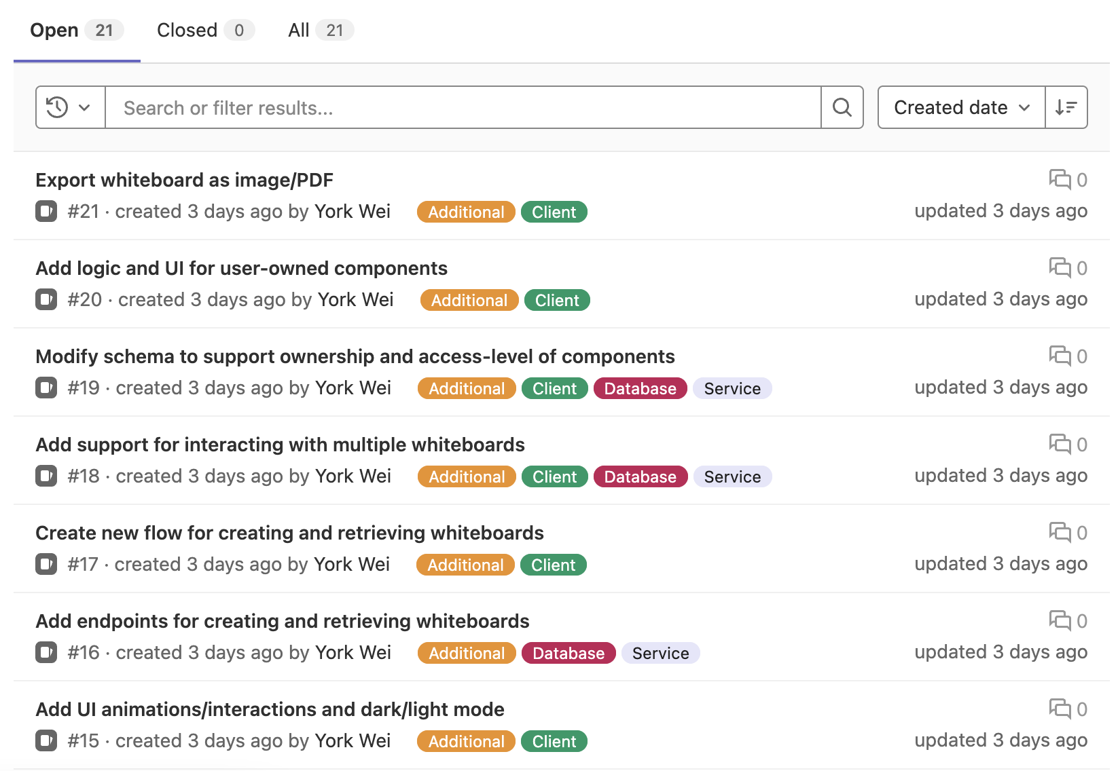
Project Requirements

Slide 3
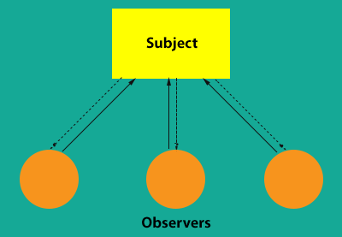
Design Patterns
Observer Design Pattern
Multiple users will be connecting to the whiteboard at once
Server will sync and publish changes to users
Decorator Design Pattern
UI will have a base window
User will have the ability to specify any combination of features.

Slide 4
User Interviews, Personas, and Extra Features

Slide 5
Risks and Mitigation

Slide 6
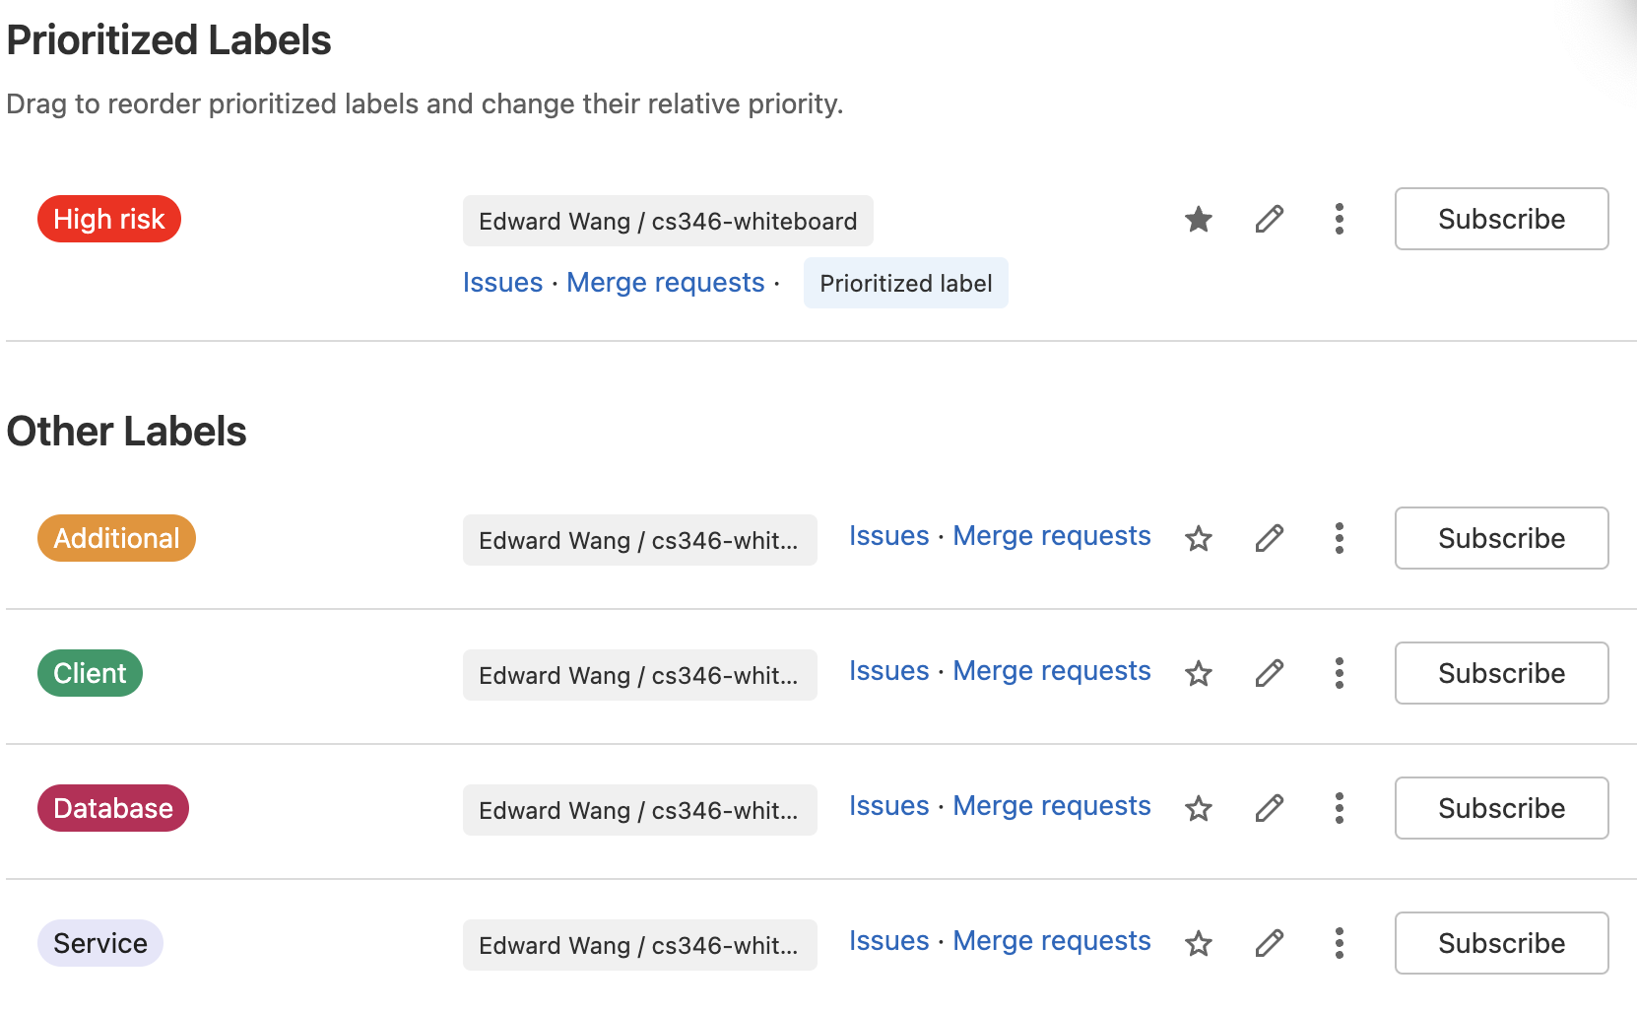
GitLab Project Setup

Slide 7
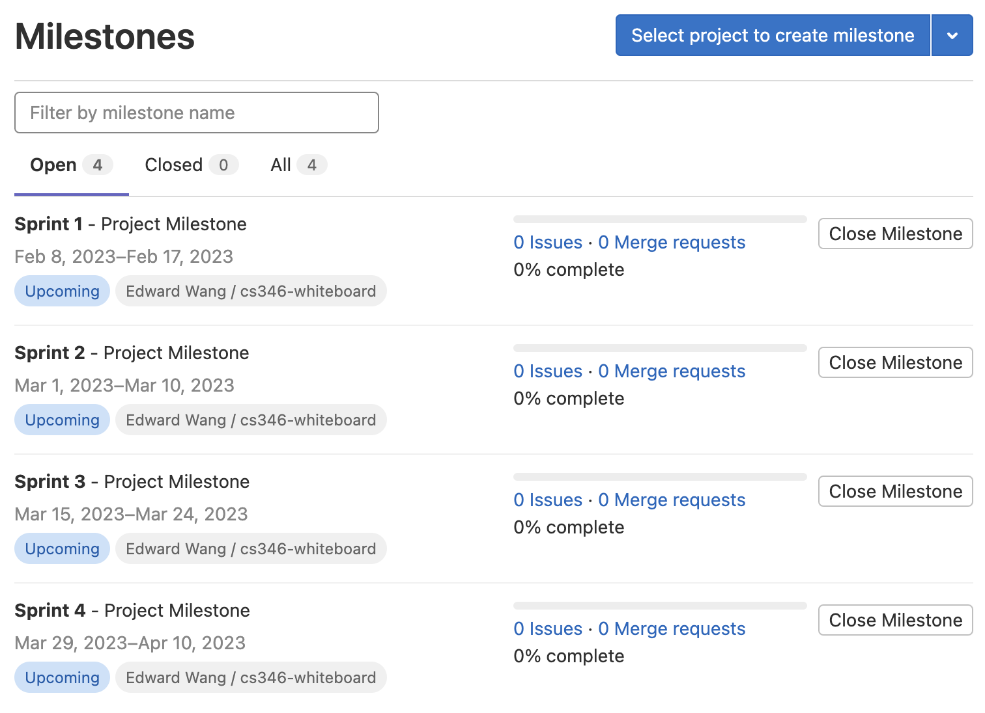
GitLab Project Setup

Slide 8
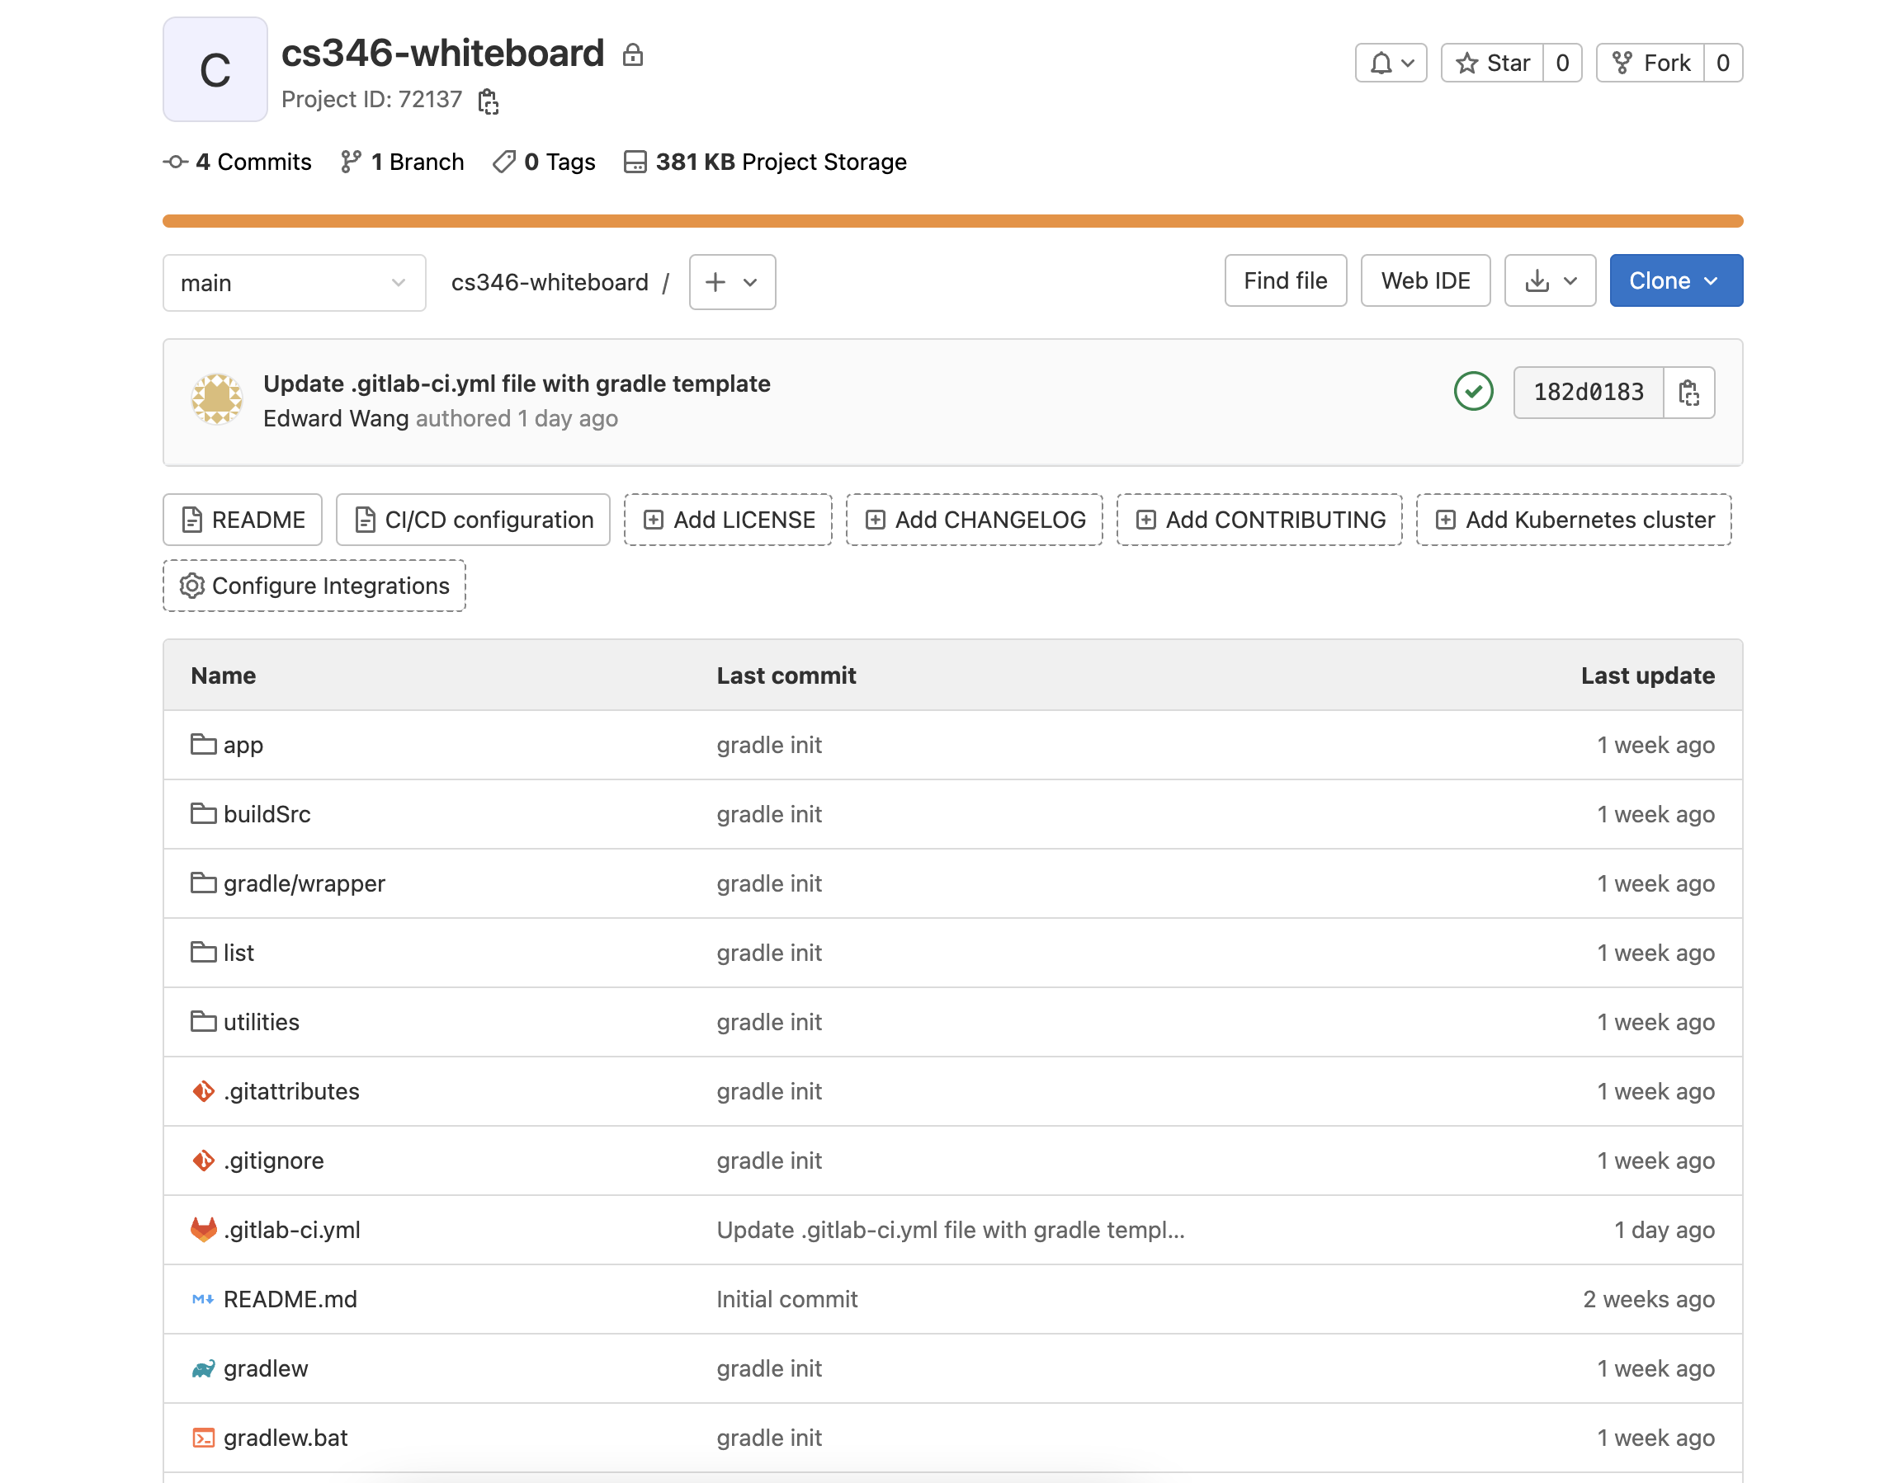
GitLab Repo

Slide 9
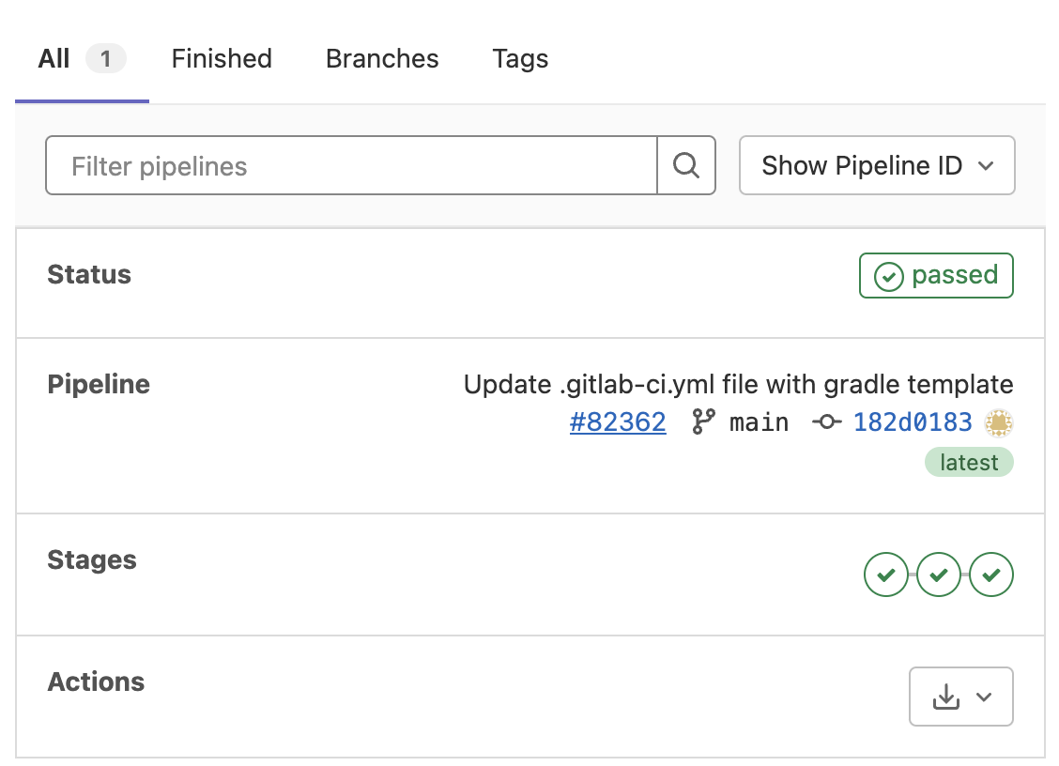
CI/CD Setup

